Slide 1

Vel Tech Rangarajan Dr. Sagunthala R&D Institute of Science and Technology
School of Computing
Department of Computer Science and Engineering
10211CS224 / FULL STACK APPLICATION DEVELOPMENT (JAVA)
END SEMESTER PROJECT REVIEW
Date: 06-05-2026
TICKET BOOKING SYSTEM FOR TECHNICAL FEST
SDG: SDG 4, 9 – Quality Education , Industry, Innovation & Infrastructure
Presented By:
K.L.P. MADHUKSHA – VTU25666 – 23UECS1115
Courses Handling Faculty:
Dr. Sumithra M. – Assistant Professor(SG)

Slide 2
INTRODUCTION
1
Most technical festivals still rely on manual registration or fragmented department-level spreadsheets.
This reliance leads to data silos, ticket overselling, and delayed communication for venue changes.
Our project is vital because it centralizes event management into a single, unified microservices platform.
It ensures a seamless user experience by automating ticket inventory and personal booking history.
Real-world relevance lies in providing instant, automated notifications for any administrative updates.
The system utilizes a distributed architecture to handle high traffic from multiple departments simultaneously.
The project comprises four specialized services: Discovery, User Auth, Event Inventory, and Booking.
In summary, it bridges the gap between organizers and participants with real-time, data-driven management.
2
3
4
5
6
7
8
9

Slide 3
PROBLEM STATEMENT
In many academic institutions, current systems for managing large-scale technical festivals are not fully automated and rely heavily on fragmented manual work across different departments. This leads to significant inefficiencies in managing attendee data, tracking live ticket inventory across multiple events, and ensuring accurate communication. Furthermore, existing systems lack a centralized platform for students to explore all available fests or receive real-time notifications regarding venue or schedule updates. Consequently, there is an urgent need for a simple, reliable, and automated microservices-based system that can improve coordination, accuracy, and the overall user experience during the technical fest registration process.
1
2
3
4
5
6
7
8
9

Slide 4
OBJECTIVE(S)
1
2
3
To design and develop a scalable microservices-based web portal that centralizes technical fest registration and automates ticket inventory management for multiple departments.
To implement a real-time notification engine and a dedicated administrator dashboard to ensure live updates and transparent monitoring of global booking logs.
4
5
6
7
8
9

Slide 5
PROPOSED SYSTEM
System Description: A distributed microservices architecture utilizing Spring Boot and React to manage fests, users, and bookings as independent, modular services.
Unified Frontend: Centralizes all flagship technical fests onto a single platform, allowing students to browse and register without switching between multiple department sites.
Dynamic Inventory Management: Solves the issue of ticket overselling by using real-time availability counters that sync instantly with the global database during every transaction.
Multi-Attendee Automation: Addresses complex registration needs by enabling a single booking to dynamically capture unique data (name, email, dept) for every individual ticket.
Broadcast Notification System: Resolves communication delays by using a notification engine to send instant alerts to attendees regarding venue or schedule changes.
Administrative Transparency: Provides a global booking log and master event control dashboard, giving organizers real-time visibility that current manual systems lack.
High-Availability Advantage: By using the Eureka Discovery Server, the system ensures that even if one service undergoes maintenance, the rest of the portal remains operational.
Scalable & Premium UX: Offers a modern, glassmorphic user interface that can handle a larger volume of traffic and data more efficiently than traditional spreadsheet-based methods.
1
2
3
4
5
6
7
8
9

Slide 6
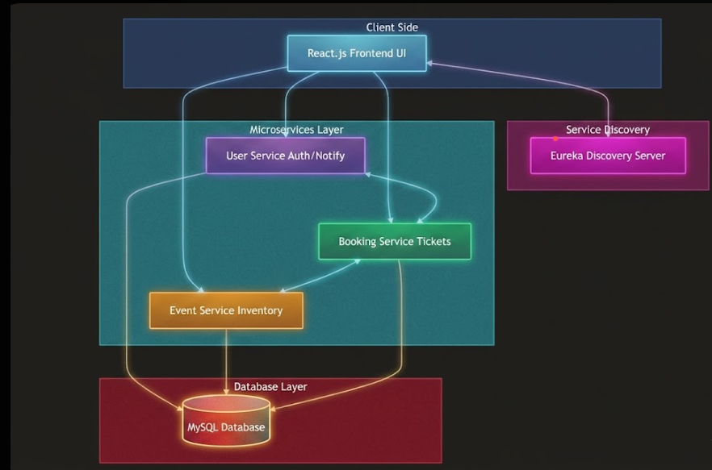
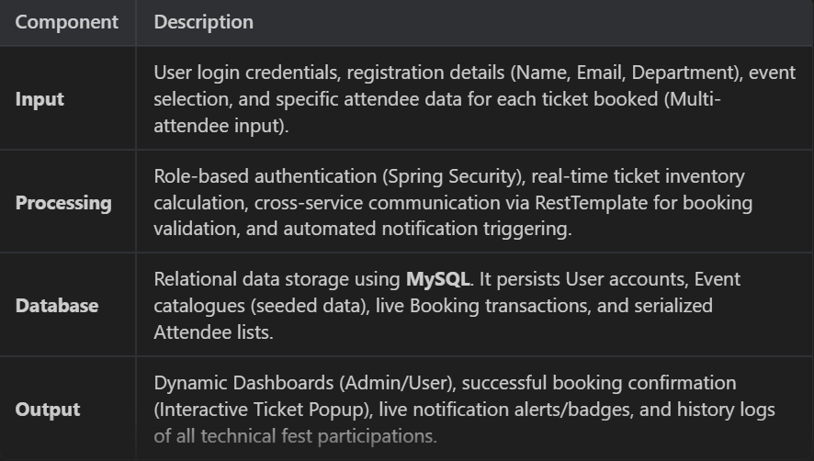
PROPOSED SYSTEM ARCHITECTURE
1
2
3
4
5
6
7
8
9

Slide 7
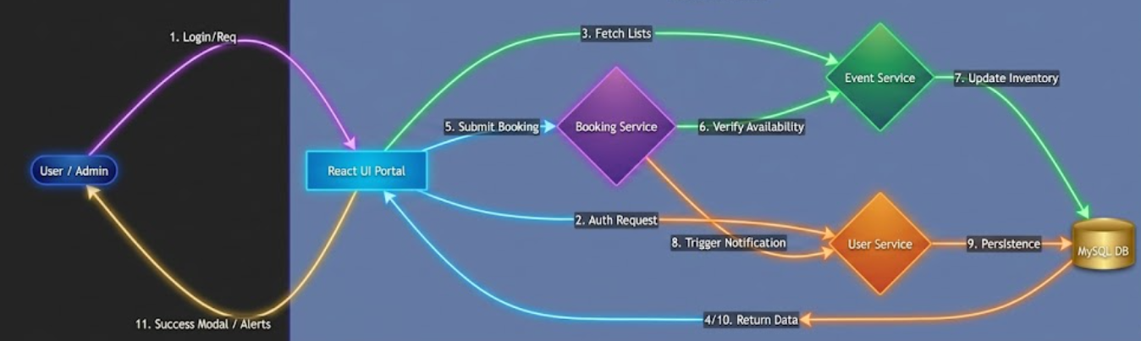
WORKFLOW
1
2
3
4
5
6
7
8
9

Slide 8
TECHNOLOGIES USED
1
Frontend: React JS, CSS3, HTML5
Backend: Java 17+, Spring Boot, Spring Data JPA, Hibernate, Eureka Service Registry.
Database: MySQL
Tools: VS Code (IDE), Eclipse(Backend), Postman (API Testing)
Hardware/Software Requirements:
OS: Windows 10/11
RAM: 8GB
Processor: Intel i3/i5/ high processor
2
3
4
5
6
7
8
9

Slide 9
MODULE DESCRIPTION
Module 1: Identity & Access Management (User Service) - Handles secure user registration, multi-role authentication (Admin/User), and maintains a persistent notification engine for real-time user alerts.
Module 2: Festive Catalogue & Inventory (Event Service) - Manages the master directory of all 10+ technical fests, including department-specific details, live ticket availability, and dynamic pricing models.
Module 3: Transactional Engine (Booking Service) - Processes complex multi-attendee ticket purchases, validates availability across services, and ensures data consistency during high-volume bookings.
Module 4: Global Control & Reporting (Admin Dashboard) - Provides administrative tools for CRUD operations on events, visibility into the global booking log, and the ability to broadcast urgent notifications to participants.
1
2
3
4
5
6
7
8
9

Slide 10
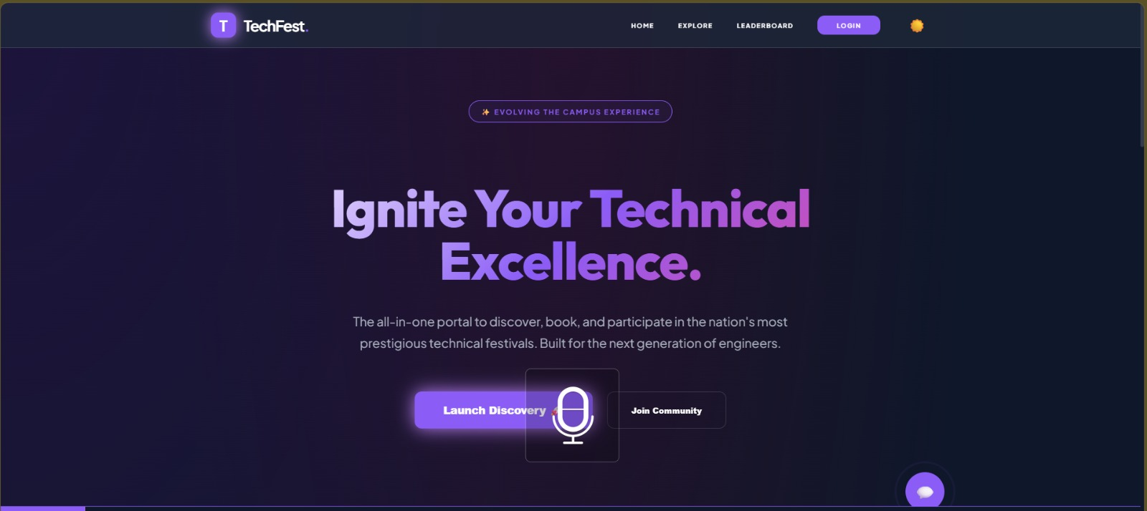
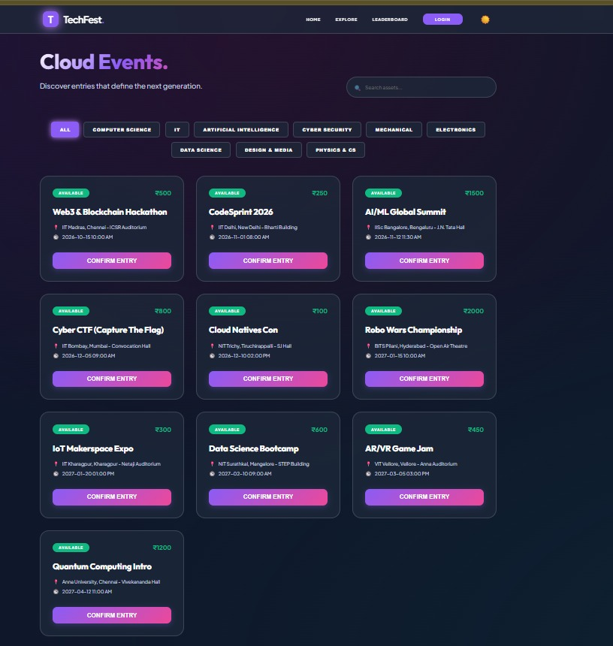
IMPLEMENTATION SCREENSHOTS
1
2
3
4
5
6
7
8
Home Page - A modern landing page introducing the Tech Fest platform with a bold headline and call-to-action buttons. It provides users with an overview of the platform’s purpose to explore and participate in technical events.
9
Events Listing Page - Displays a categorized list of technical events with details like location, date, and entry fee. Users can browse, filter, and register for events using the “Confirm Entry” option.

Slide 11
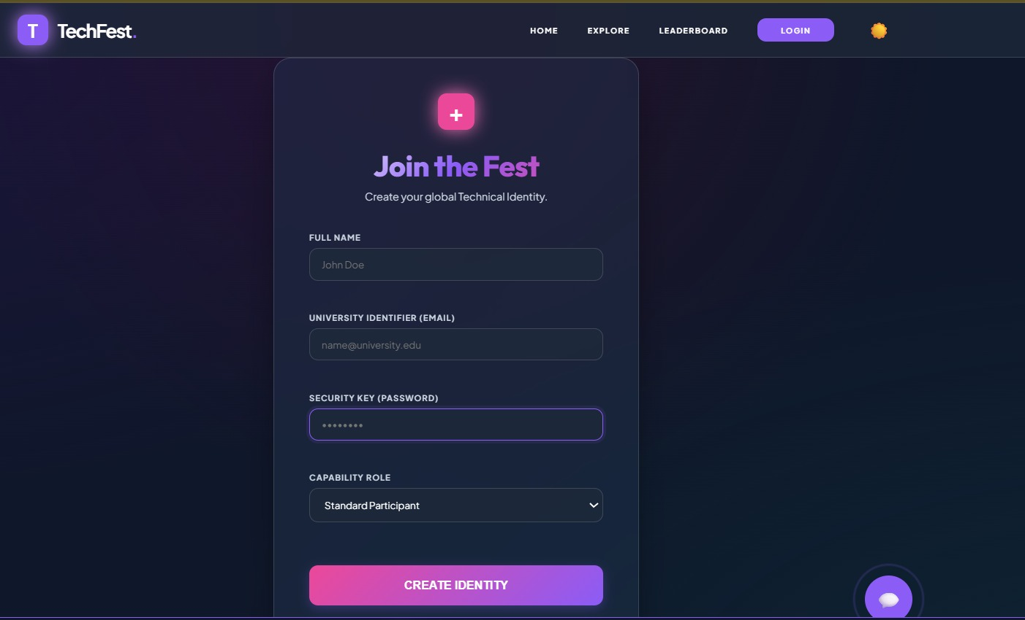
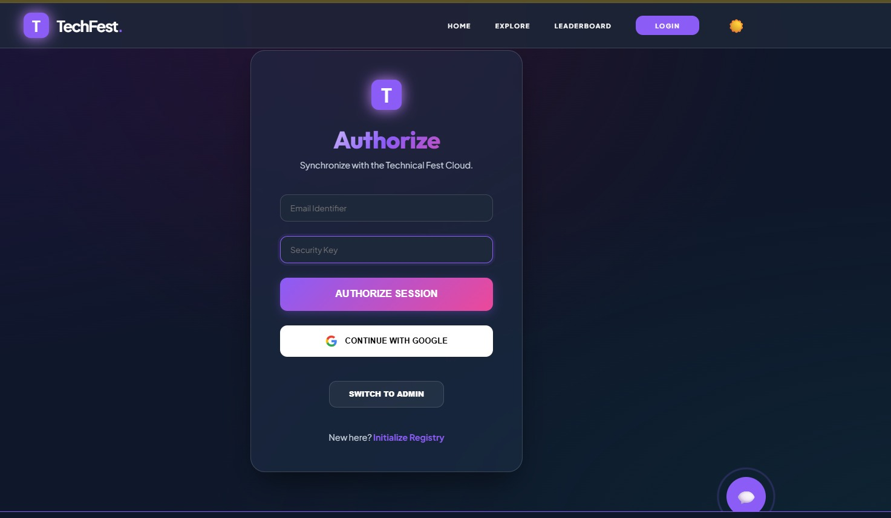
IMPLEMENTATION SCREENSHOTS
1
2
3
4
5
6
7
8(A)
9
User Authentication Module (Registration & Login Pages) - A combined interface that enables users to create an account by entering personal and university details, along with role selection and secure password setup. It also supports user login through email/password or Google authentication, with options for admin access and new user registration.
Home Page - A modern landing page introducing the Tech Fest platform with a bold headline and call-to-action buttons. It provides users with an overview of the platform’s purpose to explore and participate in technical events.

Slide 12
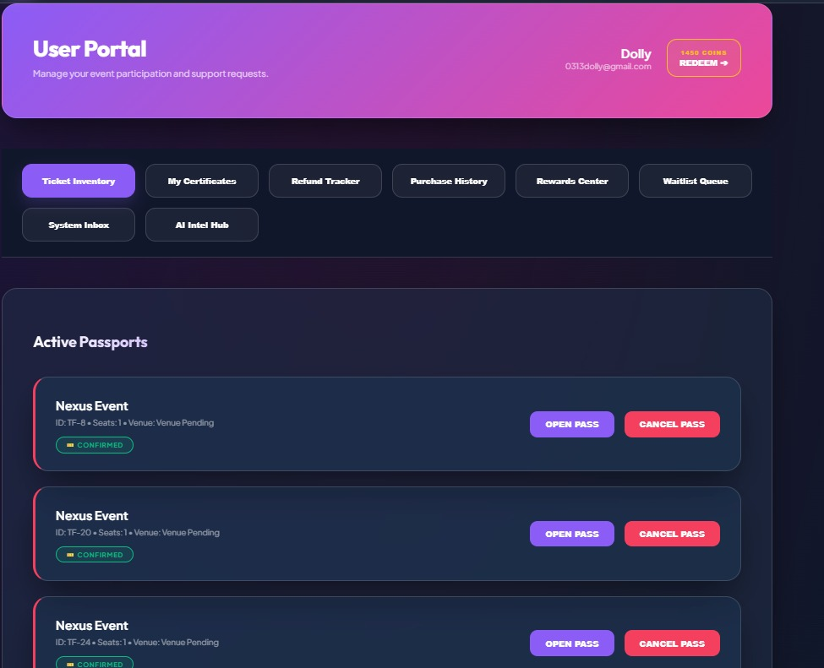
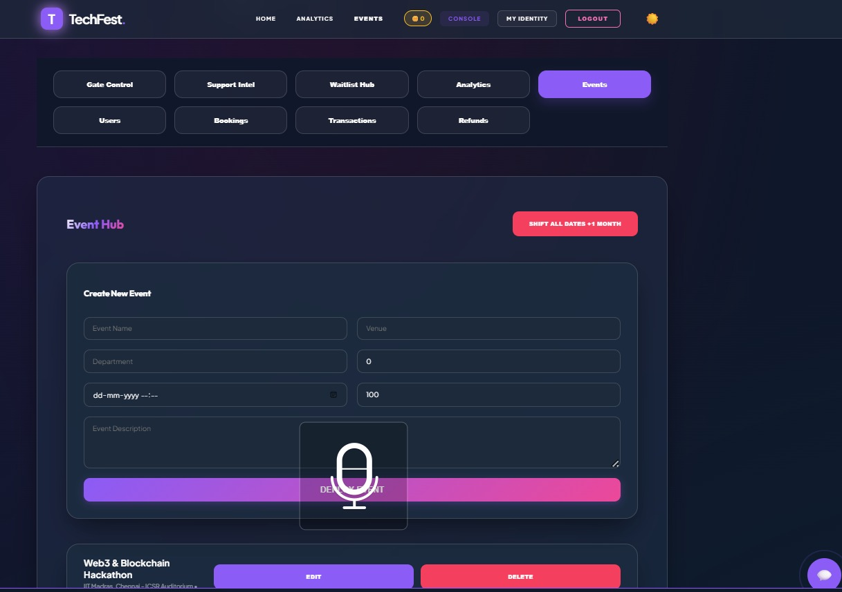
IMPLEMENTATION SCREENSHOTS
1
2
3
4
5
6
7
8(B)
9
User Portal - A personalized dashboard where users can manage their event tickets, certificates, refunds, and rewards. It displays active bookings with options to view passes or cancel entries
Admin Event Management - An admin interface for creating, updating, and managing events along with user and transaction data. It includes controls for event creation, analytics, bookings, refunds, and overall system management.

Slide 13
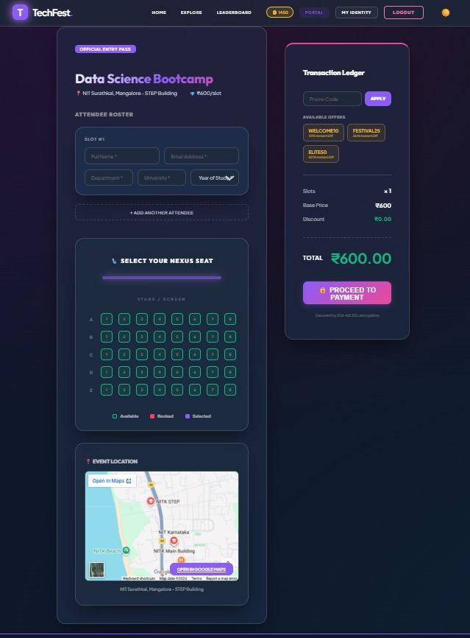
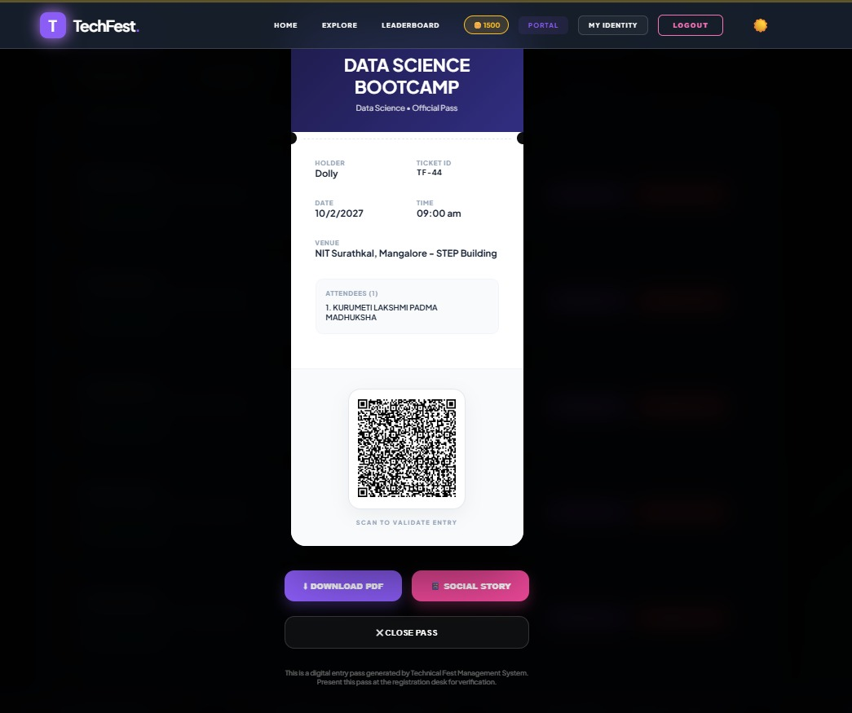
IMPLEMENTATION SCREENSHOTS
1
2
3
4
5
6
7
8(C)
9
Ticket Booking & E-Pass Generation Page - These images show the complete ticket booking and validation process, including attendee details entry, seat selection, pricing, and secure payment. They also display the generated digital entry pass with event details and a QR code for quick verification and entry validation.

Slide 14
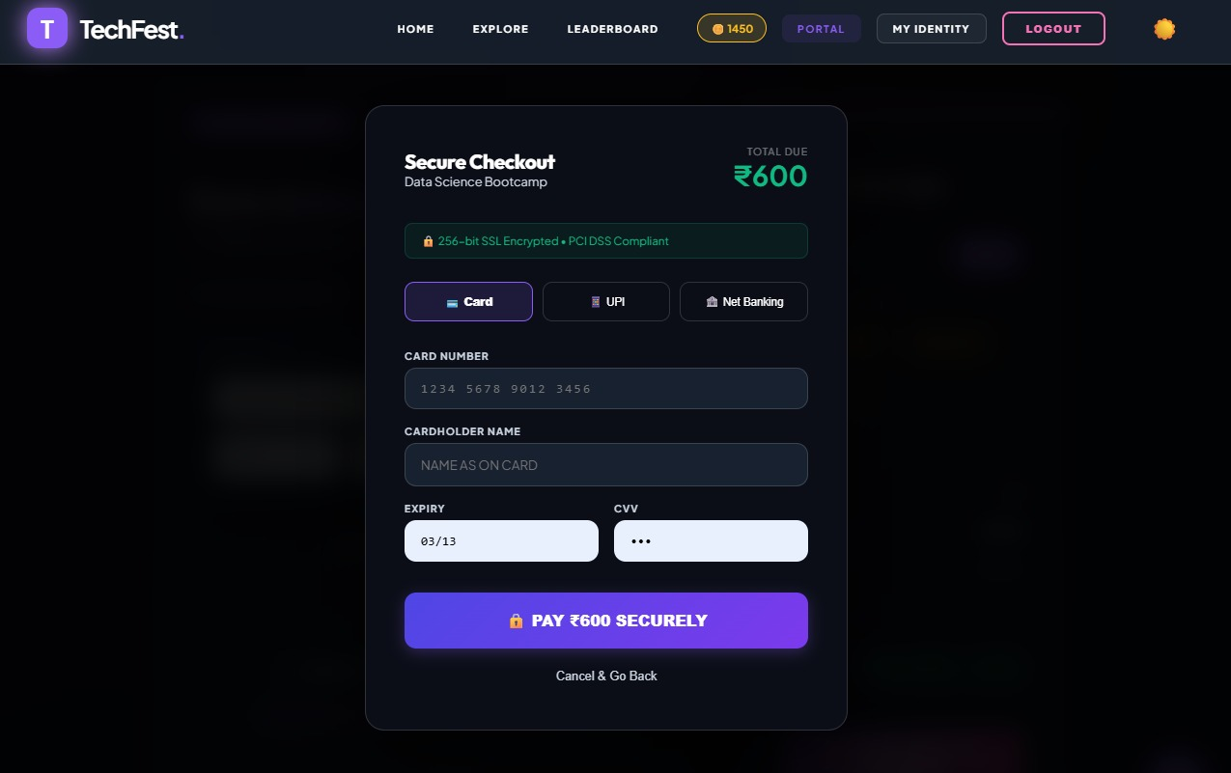
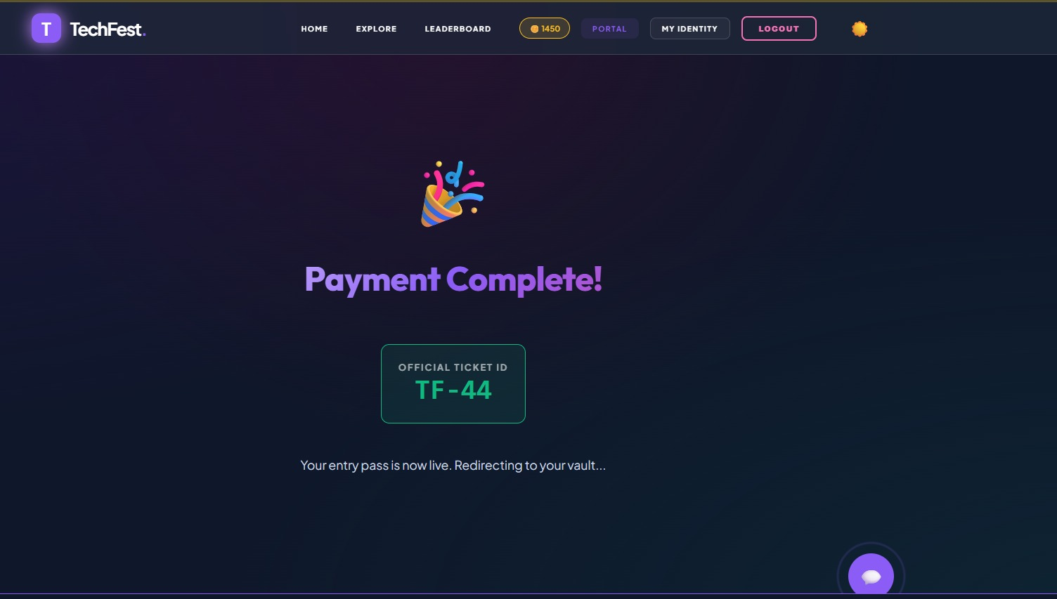
IMPLEMENTATION SCREENSHOTS
1
2
3
4
5
6
7
8(C)
Secure Payment & Confirmation Page - Handles secure payment processing with multiple options like card, UPI, and net banking, ensuring encrypted transactions.After successful payment, it displays a confirmation screen with ticket ID and activates the user’s entry pass.
9

Slide 15
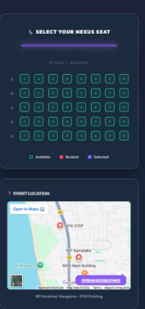
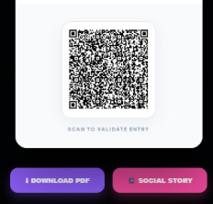
IMPLEMENTATION SCREENSHOTS
1
2
3
4
5
6
7
8(C)
Innovative Features - Provides an interactive seat selection system with real-time availability and integrated event location mapping for better planning and user convenience. Generates a secure QR-based digital pass with options to download or share, enabling quick, contactless entry and verification.
9

Slide 16
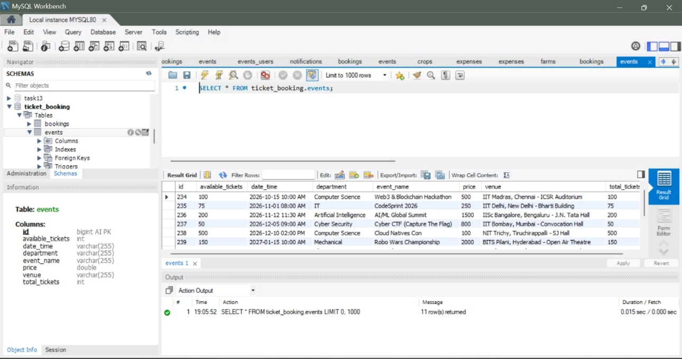
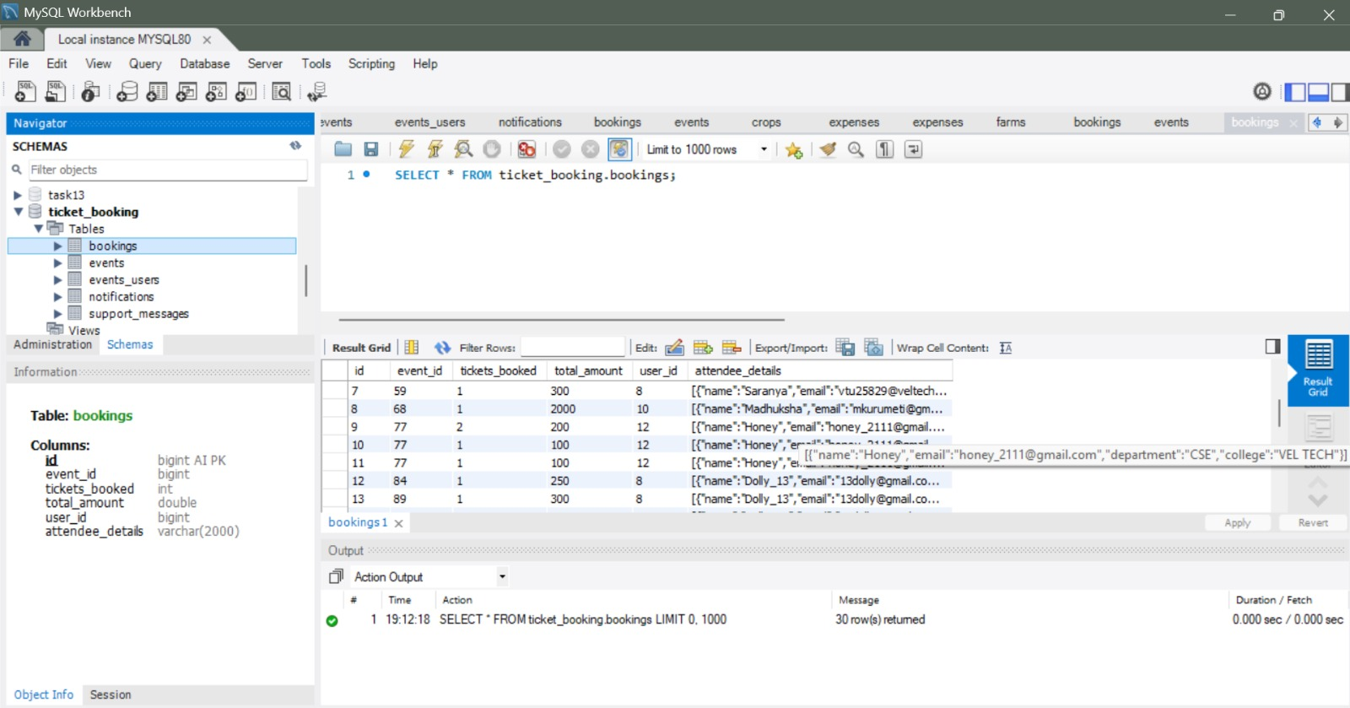
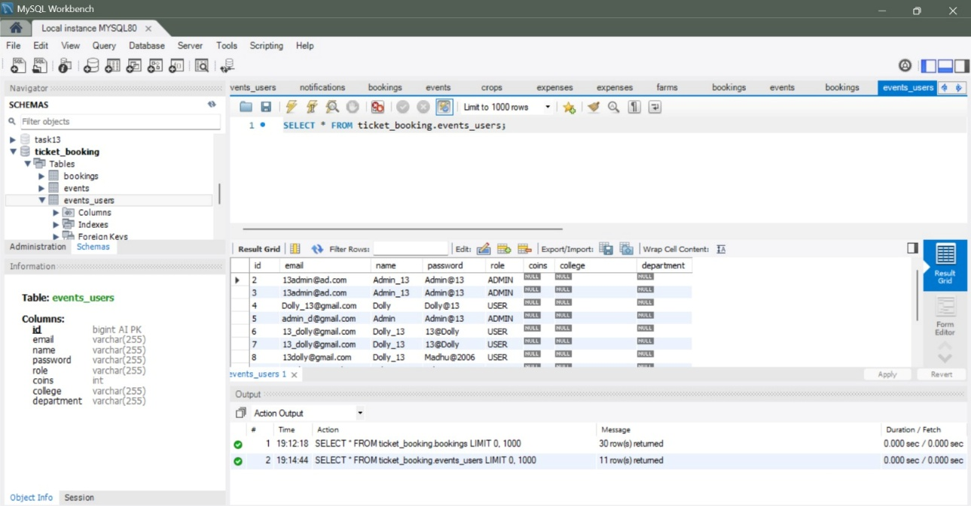
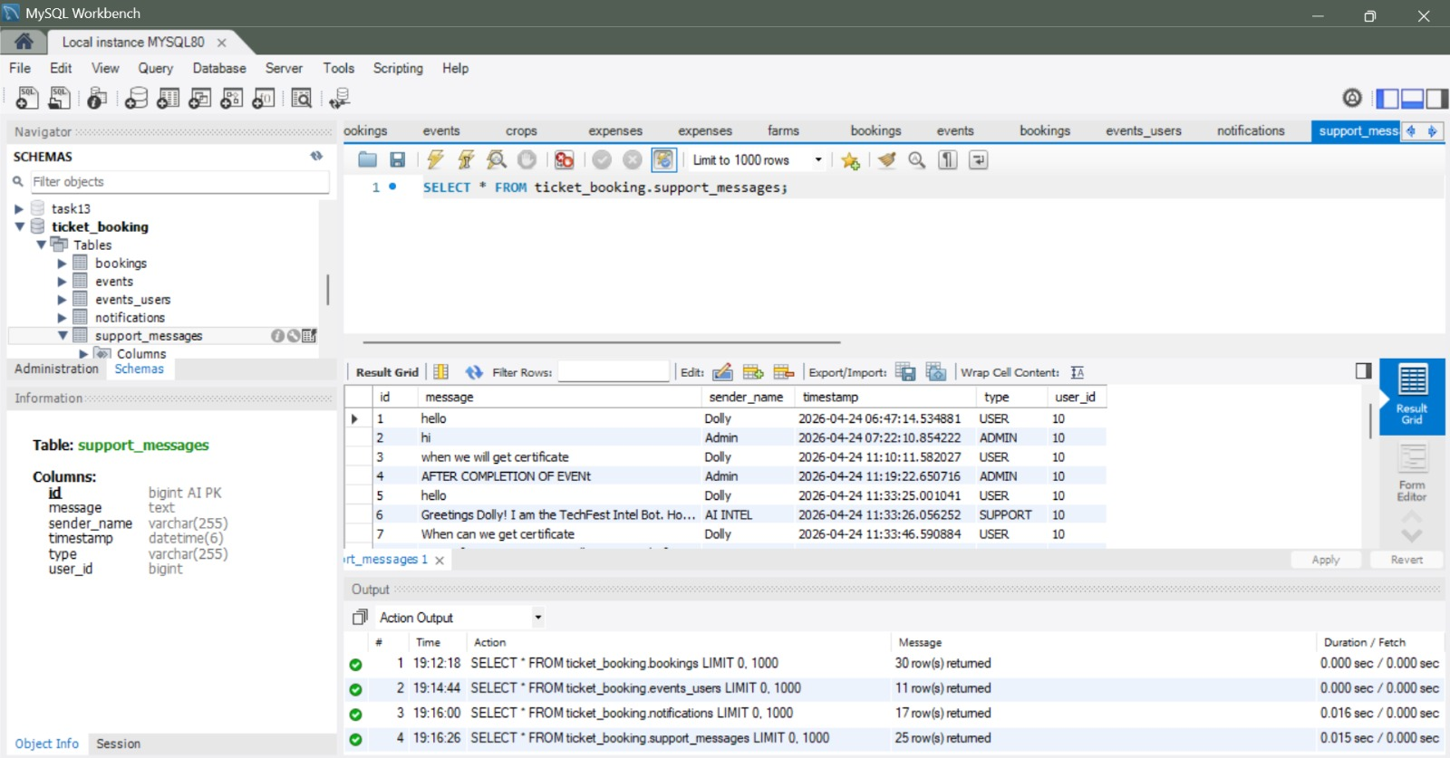
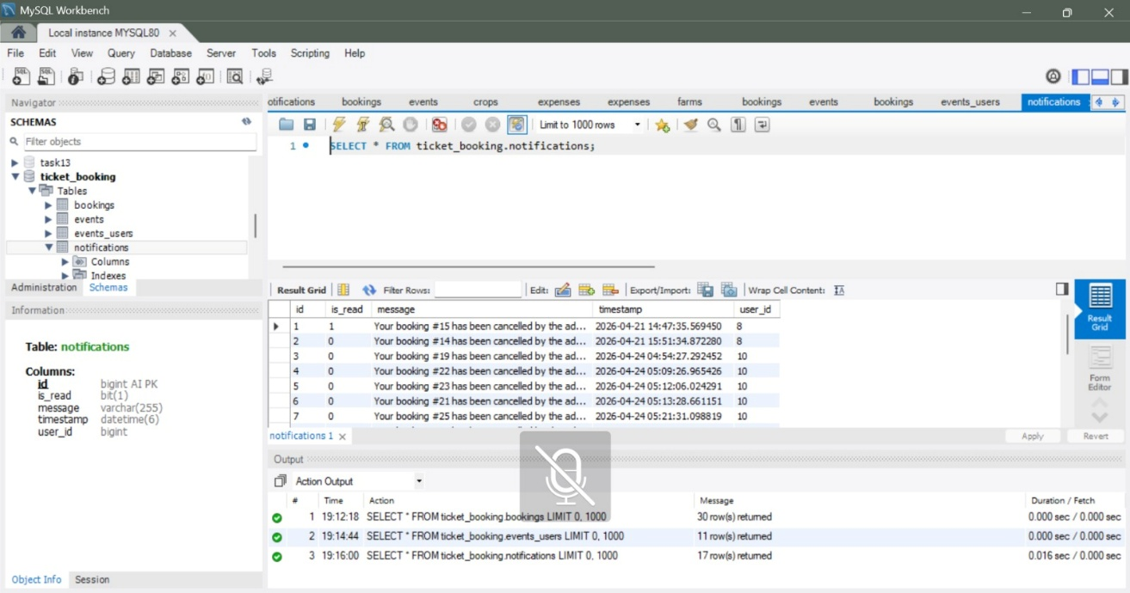
IMPLEMENTATION SCREENSHOTS
1
2
3
4
5
6
7
8(C)
9

Slide 17
ADVANTAGES & LIMITATIONS
Advantages
Distributed Architecture: Enhances system fault tolerance through microservice decoupling, ensuring that failure in one service does not crash the entire portal.
Inventory Integrity: Guarantees real-time ticket validation across concurrent users to prevent overselling through a dedicated event-logic controller.
Dynamic UX: Features a live notification engine that provides immediate feedback and alerts regarding administrative updates directly on the user dashboard.
Rich Asset Handling: Implements a unique, glassmorphic design system that ensures a premium and responsive interface for both desktop and mobile views.
Limitations
Payment Processing: Currently focuses on the technical registration workflow and does not yet include a live integrated third-party payment gateway.
Physical Ticketry: While it generates interactive digital logs, it lacks automated PDF generation and QR-code scanning for on-spot physical check-ins.
Cloud Persistence: Designed for a local localized server environment, which would require Dockerization for horizontal scaling during massive traffic spikes.
Dependency Constraints: Requires a stable network connection to the Eureka Discovery server and MySQL instance to process any transactional bookings.
1
2
3
4
5
6
7
8
9

Slide 18
Thank you

